Slide 1
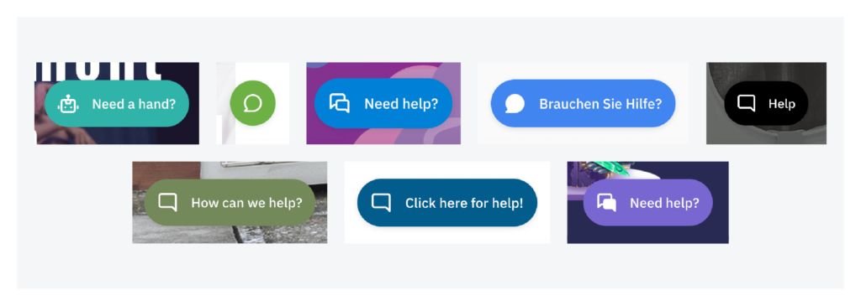
Using Widgets with your HTML/CSS Site
By Connor Boone and Amanda Guilland

Slide 2
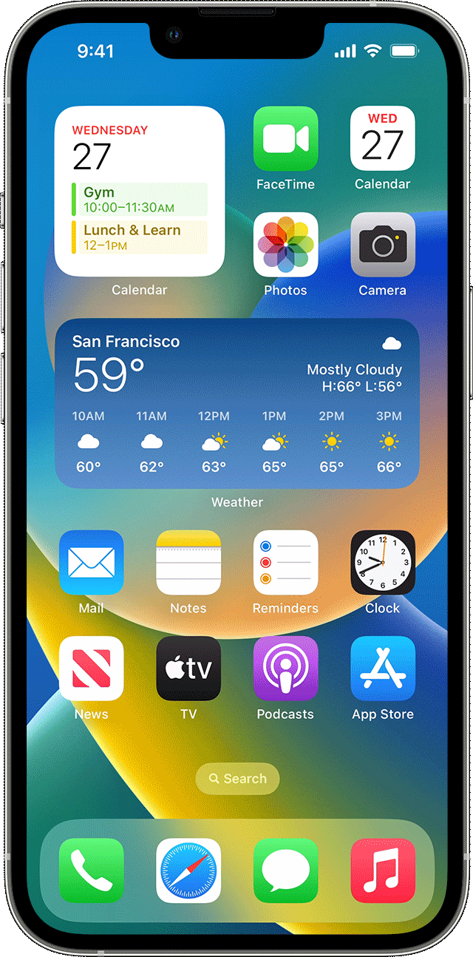
What are Widgets?
If you have a smartphone, you’ve likely already used widgets before!
Not to mention the countless number of sites that use them as well…
Extension of an application - generally focus on one task
The Clock app lets you set alarms, use the stopwatch, start a timer, etc. while a Clock widget would simply display the time.
Web Design: Third-party applications that are embedded onto a webpage
Clocks, calendars, chat buttons, contact forms, etc.
Easy to set up and can be embedded from many different sites without significant changes to the backend coding
Some sites do charge a small subscription fee as well as having a free tier for demos
Useful for any website, but especially for smaller businesses
A few examples of the various types of widgets to embed on your page:
Sign-up form to add customers to a blog / newsletter subscription
Social media posts to let your customers share them directly from your site
Scheduling widget to let customers book appointments
Chat widget to make it easier for customers to reach out
Google Maps widget to allow your customers to easily find your business’s location
Event calendar to display upcoming events
PayPal button to allow customers to pay for services / items through PayPal
And many more!

Slide 3
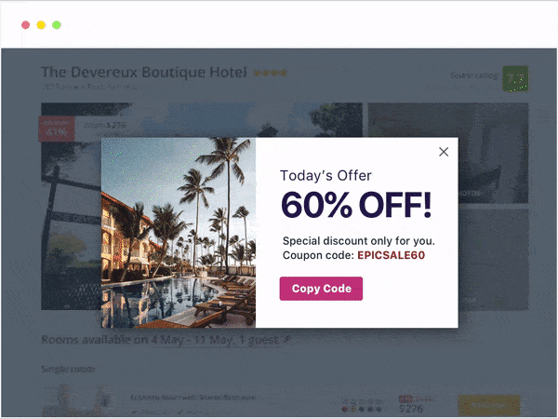
How are they used in web development?
Creating a more personalized user experience
Add functionality and interactivity without requiring programming skills
Save time and money
Compared to developing your own widget
Increase website traffic
Notes:
Talk about the process, how we used Elfsight to customize and embed widgets for free
Adding a script and a div to your code to embed the widget to your page

Slide 4
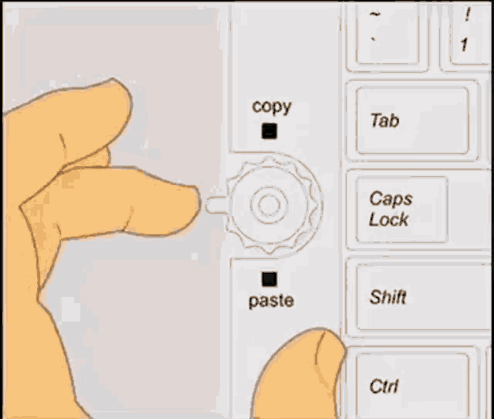
Create your own vs. Copy?
Make your own
Copy and paste
Can be expensive
Skills required
Time consuming
Can be high maintenance
Less costly
Easy
Quick
Very customizable
Elfsight allows for custom CSS and JS within the widget
If you can think it, someone’s probably made it
Notes:
There’s lots of already made widgets out there
A lot of customization available to make it your own
Elfsight even allows custom css and javascript
Obviously more work to create your own, but certainly not impossible

Slide 5
LOGO
Social media icons
Countdown Timer
Customer Testimonial
Product Img
Product Img
Product Img
Product Img
Product Img
Product Img
Name
Price
Name
Price
Name
Price
Name
Price
Name
Price
Name
Price
Product Img
Product Img
Product Img
Product Img
Product Img
Product Img
Name
Price
Name
Price
Name
Price
Name
Price
Name
Price
Name
Price

Slide 6
Widgets Used:
Countdown link: https://widget-c79c0c4022434fa28249c3fcd75fd6cb.elfsig.ht
Testimonial link: https://widget-acb55558156f4c13a99c7a8bd99c7f78.elfsig.ht

